Slide 1
Web App Project by: Jamielyn Agliam

Slide 2
Purpose
The web app’s purpose is to give information or to educate children about the solar system in a more exciting way.
After learning about the basic information of the solar system, they would have a chance to test what they’ve learned through playing a game (either quiz)

Slide 3
WEB APP DESIGN

Slide 4

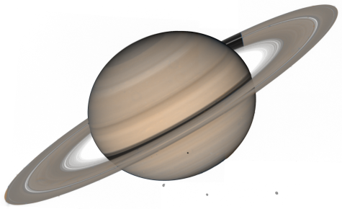

SOLAR SYSTEM (Click the planets to see its information)
LEARN
PLAY

Slide 5
SOLAR SYSTEM (Click the planets to see its information)
Planet Name
------------------------
Basic information about the planet…
Radius:
Mass:
Distance:
Rotation:
Moons:
LEARN
PLAY
Close

Slide 6

SOLAR SYSTEM
LEARN
PLAY
What is the of this planet?
a. Jupiter
b. Mars
c. Saturn
d. Neptune

Slide 7
SOLAR SYSTEM
LEARN
PLAY
What is the of this planet?
a. Jupiter
b. Mars
c. Saturn
d. Neptune
CORRECT!

Slide 8
SOLAR SYSTEM
LEARN
PLAY
What is the of this planet?
a. Jupiter
b. Mars
c. Saturn
d. Neptune
WRONG

Slide 9
END

